Slide 1
1095-B Business Owner Brief
FRIDAY, JULY 29TH, 2022

Slide 2














Get to know the team
Core team
Executive team
PRODUCT
ENGINEERING
Munish Sikka
Washington DC
Product Lead
Tami Corson
North Carolina
Clinical SME / Scrum
Dan Smith
Charleston, SC
QA Engineer / 508 Specialist
Shashank Khandelwal
Rockville, MD
Tech Lead
Travis Hoffman
MO Studio
Marcy Jacobs
McKinsey & Co
Kevin London Frog Design
DESIGN
Teagan Stephenson
Ft. Lauderdale, FL
Full Stack Engineer
1095-B Product Only
Thomas McCue Oak Park, IL Principal Designer Director
Carl Dickerson Atlanta, GA Content Strategist
Carolyn Williams Chicago, IL Experience Designer
Will Reynolds SERVE Advisory
Ben Morris
Pluribus Digital
Jeanette Cantrell
MO Studio
Introduction
Notes:
Jeanette

Slide 3
1095-B MVP launch
1095-B workplan
MVP design updates
Product functionality
Spanish translation for 1095-B documents
1095-B post-MVP
Paperless Delivery
1095-B extended timeline
Agenda
Agenda
3

Slide 4
1095-B MVP Launch
BUSINESS OWNER BRIEF

Slide 5




1095-B workplan
Owned by VA team(s)
Release
WE ARE HERE
SPRINT 7
4/20 – 5/03
SPRINT 8
5/04 – 5/17
SPRINT 9
5/18 – 5/31
SPRINT 10
6/01 – 6 /14
SPRINT 11
6/15 – 6/28
SPRINT 13
6/29 – 7/12
SPRINT 14
7/13 – 7/26
SPRINT 15
7/27 – 8/09
SPRINT 16
8/10 – 8/23
SPRINT 17
8/24 – 9/6
1095-B: Spanish translation docs
Turnover document of remaining post-MVP work (VA notify, 2022 IRS form, 508 compliance, multiple year selection)
1095-B: Legal Review
1095-B: Legal Review – Opt-in
Product & Delivery
VA 508 Assistance request
MVP 508 Spanish translation docs
Kickoff
Align on launch MVP v. MVP w/ opt-in
Draft opt-in legal review package
Design for opt-in
Launch communication plan
User Experience & Design
Notification flow
Design for MVP 508 accessibility
1095-B Wayfinding
Build for accessible MVP
Build notification triggers
Build for Opt-in
Engineering & Development
Tech feasibility opt-in build
Build for wayfinding
Build Analytics for launch monitoring
Collaboration Cycle
Sitewide and Content IA ticket opt-in
Call center review
Analytics & QA
MVP staging review
1095-B Post launch evaluation
Security &
privacy review
MVP launch
1095-B Workplan
Notes:
Jeanette

Slide 6
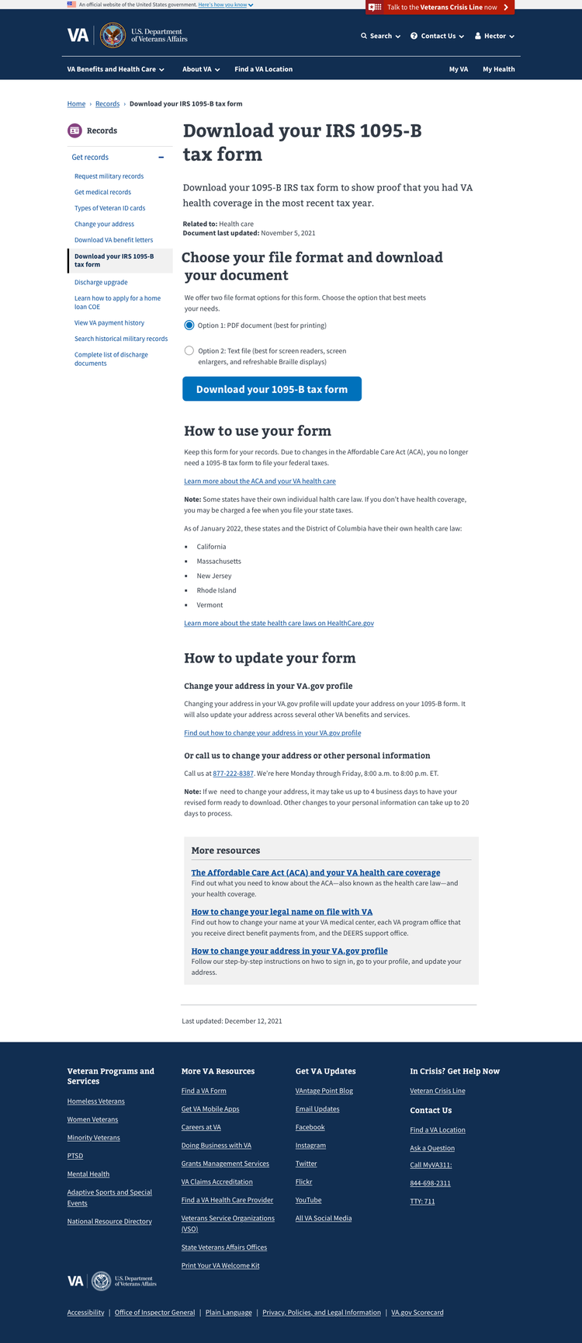
MVP design updates
The original 1095-B PDF was not accessible
We added a text file version of the 1095-B (an official IRS version) – a more accessible format that is screen reader and assistive technology friendly
Our new MVP design features radio buttons to select document download format
PDF offers printability and recognizability; text file offers accessibility
1095-B MVP
Notes:
Carl

Slide 7
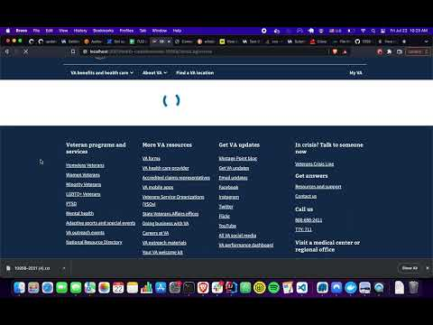
MVP product functionality
Backend development for PDF and Text file download functionality is complete and being tested in staging
We have built a clickable prototype and recorded a product video outlining the complete MVP functionality for the 1095-B download page
1095-B MVP
Notes:
Carl

Slide 8
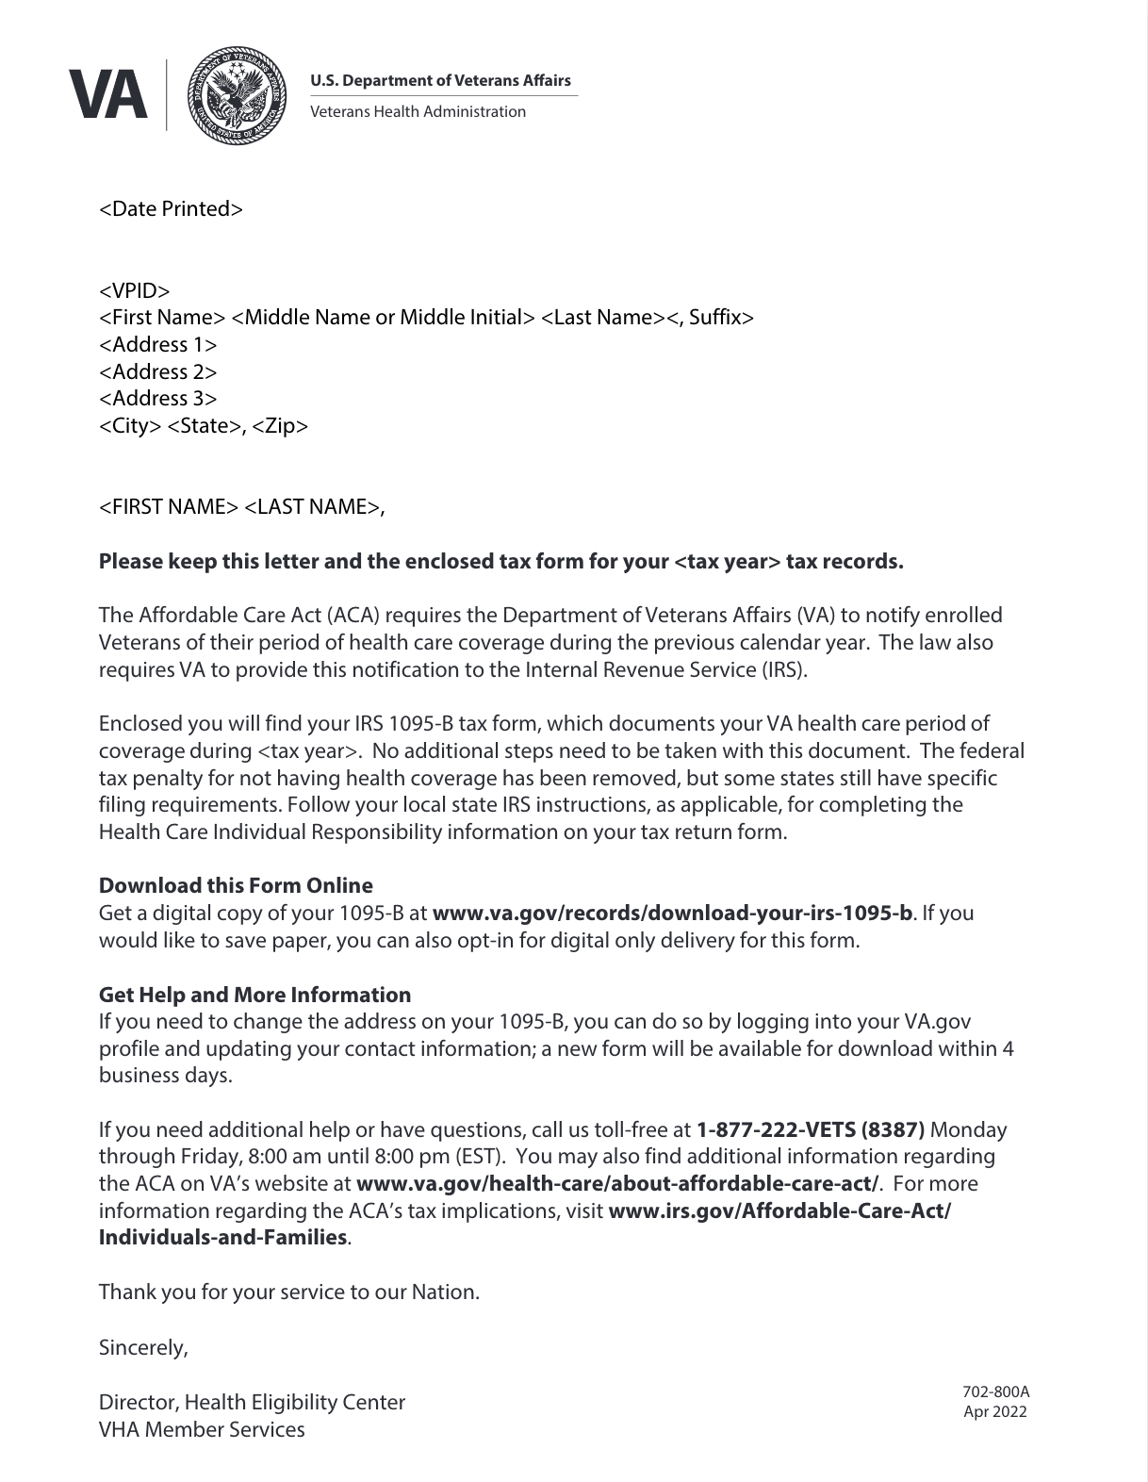

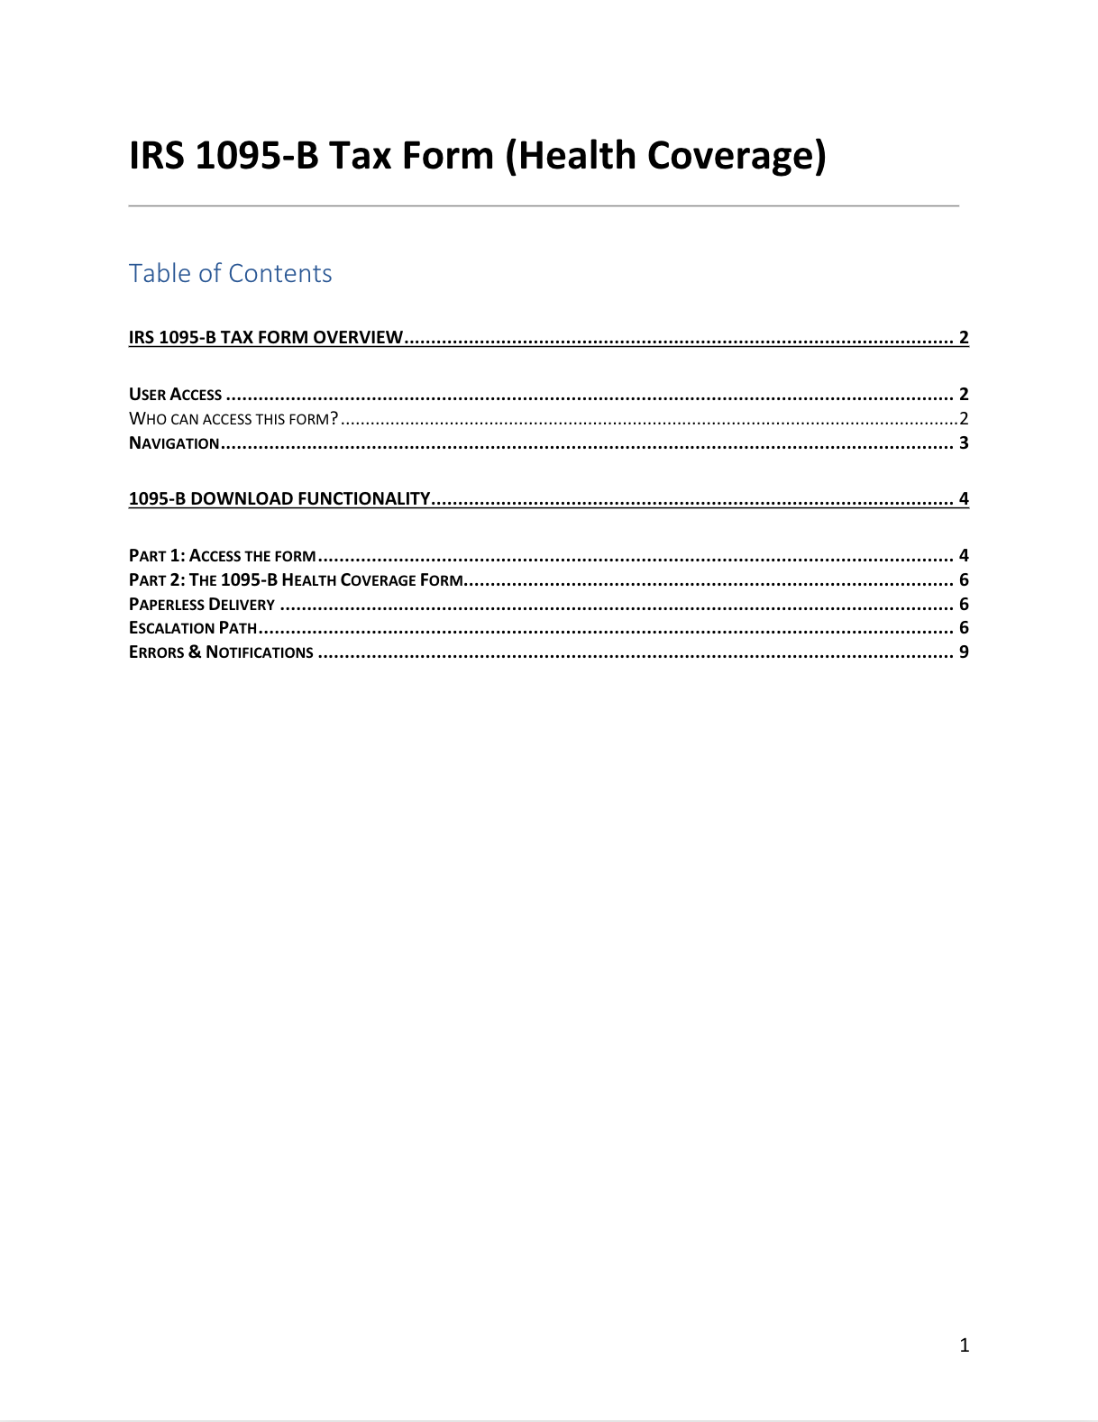
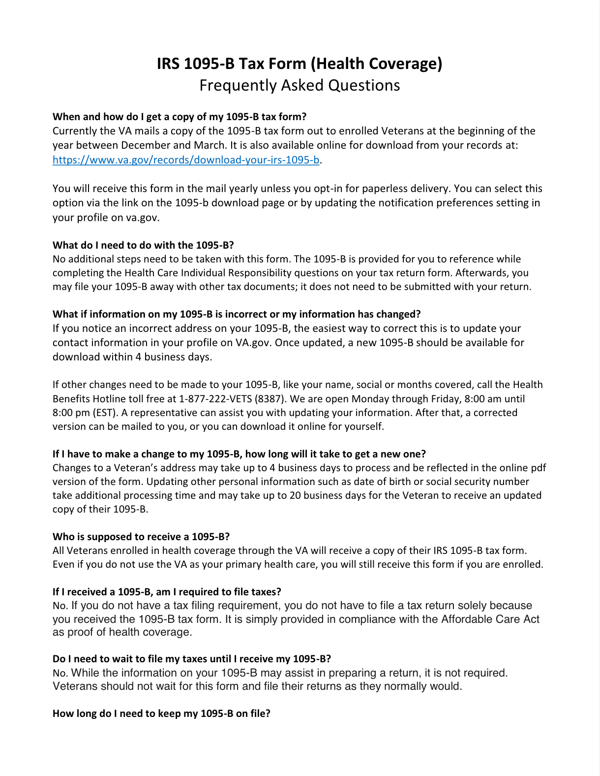
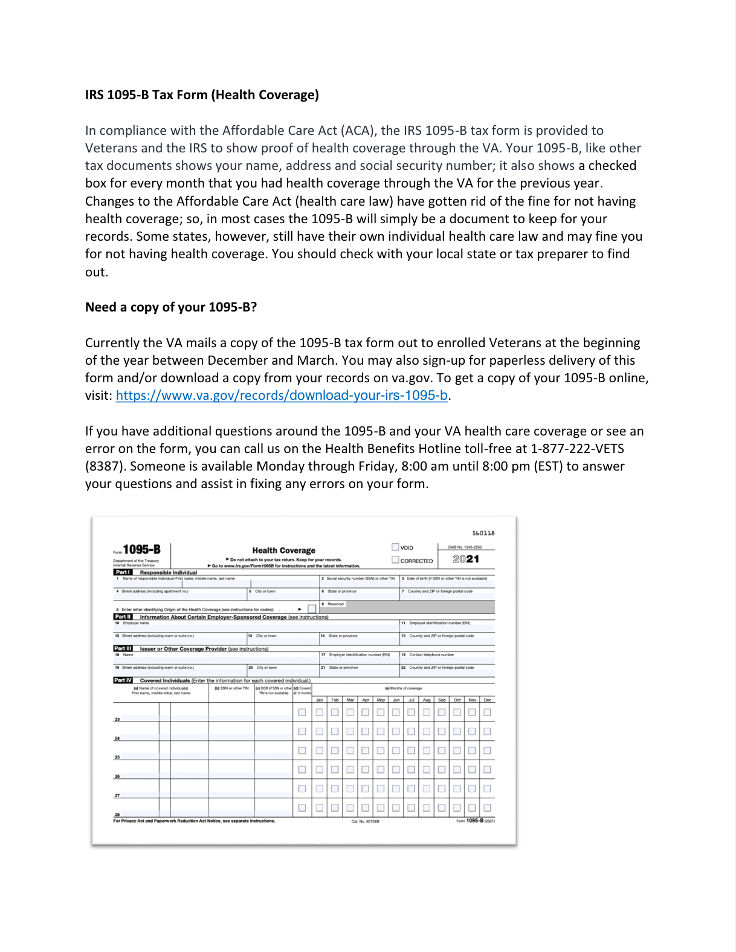
Spanish translation for 1095-B documents
Revised 1095-B product documentation has been submitted to State Department for translation
Documents to be translated:
SOW Web Content Contract
HEC Fact Sheet
HEC User Guide
1095-B Landing Page
HEC FAQ
Cover Letter (for mail)
Not expected prior to MVP launch
1095-B Legal review
Notes:
Carl - confirm that this is not required for launch

Slide 9
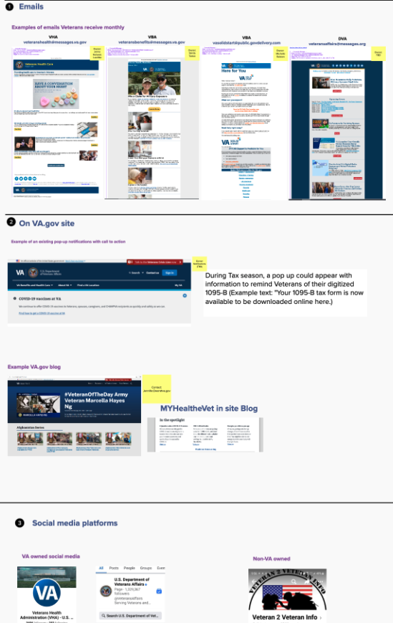
Follow-up questions for communications rollout
How do we want to communicate to Veterans that they can now get their 1095-B online? Who owns this communication?
MVP and Paperless Delivery will not launch at the same time. Will there be separate communication plans for each or should announcements be delayed to coincide together?
Current work with VANotify is to send launch emails, yearly notifications and triggered emails for opt-in/out – are there other communications you would like for our team to design?
Other channels to be considered for Communications Rollout Plan?
1095-B Communication plan
Notes:
Carl
Emails – VHA, VBA, DVA
VA.gov – top-bar notification, cross-links, posts on VA.gov blog
Social media platforms – VA-owned (Twitter, Facebook, etc.) and non-VA owned (Veteran 2 Veteran info, etc.)
VA.gov help line – e.g., insert a prompt about Form 1095-B into the hold message

Slide 10
1095-B Post-MVP
BUSINESS OWNER BRIEF

Slide 11
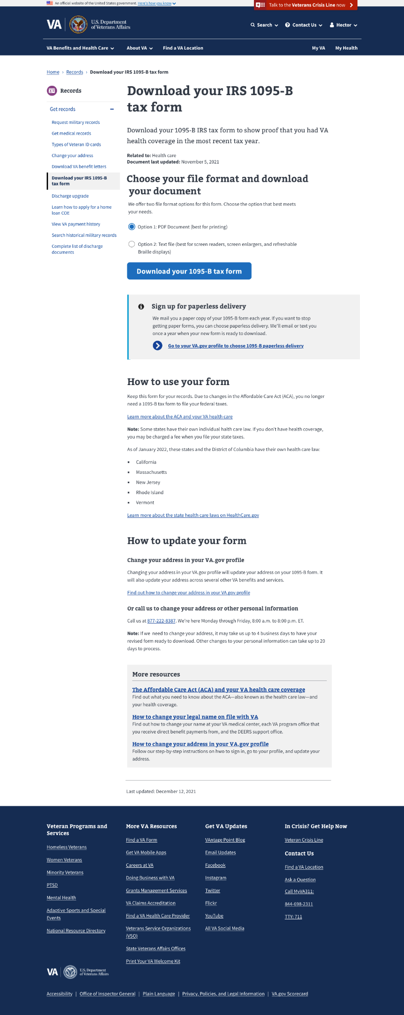

Paperless Delivery
Design has been approved for a Post-MVP Paperless Delivery sign up feature
Delivery preferences will be managed (and stored) in VA.gov profile
Veterans will receive a confirmation email each time they update their delivery preferences
1095-B Post-MVP
Notes:
Carl

Slide 12



1095-B extended timeline
Owned by 1095-B
Owned by Sitewide
Owned by Profiles teams
Requires coordination with HEC
Complete
Remaining sprints
September ⇒ 3.5 Months
1095-B Landing Page for Digital Retrieval
Designed Landing Page for Opt-in
Launch 1095-B Landing page
1095-B
Post Launch Monitoring
1095-B
Designed Blast and Annual Notifications
Build Blast and Annual Triggers – 1095-B & HEC (Joshua)
1095-B Wayfinding
Sitewide
Communication Strategy
1095-B & HEC
Opt-in to Paperless Delivery
Designed for Opt-in Component on landing page
Design for Opt-in Component in Profile - VA.gov Profile
Build link Profile to Veterans profile - VA.gov Profile & VA Profile (mike)
Build Opt-in / Opt-out Notification Triggers - VA.gov Profile
Designed Opt-in and Opt-in Notifications
HEC OGC Legal Review of Opt-in
1095-B & HEC
Enable Opt-in Link on landing page - 1095-B
Aligned on Opt-in build Req / Response
Build BE Veterans Profile to Enrollment System for Opt-in - VA Profile (Mike) HEC (Joshua)
Communication Strategy
1095-B & HEC
1095-B Post-MVP
Notes:
Shashank

Slide 13
Questions?
Notes:
Jeanette

